Slide 1
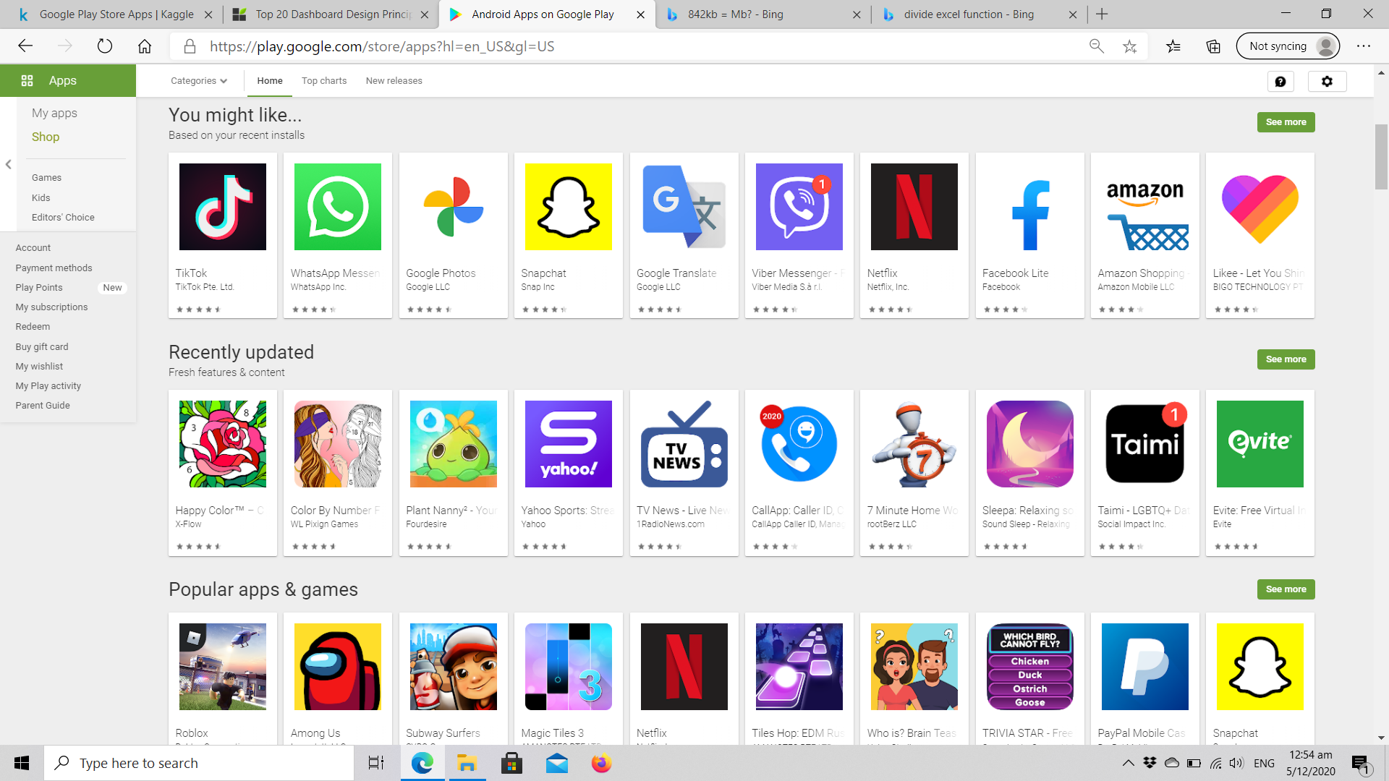
Google Play Store Apps
Analyse Google Play Store Data to Gain Insights into Android Apps Market

Slide 2
Google Android
Android Devices : 87% of global smartphone market¹
Next Few Years : Google to increase shares over Apple’s iOS²
Google Play Store Data : Understand the Android Apps Market
WHO ? Apps Developers: Drive successful Apps
Sources: ¹Statista, September 2019 | ²Sensor Tower, January 2020
Notes:
Android devices held 87% market in 2019.
Expected to increase shares in the next few years.
To break into the Android Apps market, we need to understand the market. This can be done by analysing the Google Play Store Data.
Who would be interested in this presentation? They would be.. With the intention to drive successful Apps to earn money.

Slide 3

ASKING THE WHATS?
App Creation-Maintenance
WHAT is in the Market?
3
DESIGN/
DEVELOPMENT
WHAT drives a successful App?
WHAT is the Market Trend?
Notes:
Before we dive into analysing the data, we asks the Whats? Referencing to the WHATS, we would then sought to get the answers to the WHATS in our data analysis.
0) Kick start the App Lifecycle: @ Design/Development -> Testing -> Build/Deployment -> Prototyping -> Finished Product -> Lifecyle Maintenance
1) Differentiate your App from what is already available in the market: Have unique features and stay upfront in the competition.
2) End-Users development: makes app more beneficial to users, and also cut costs in short & long term.
3) Incorporate these factors and ideas into the D&D of your App. Also to plan your resources including your human talents, technical capability, operation costs & lifecycle maintenance.
4) App maintenance over long period time: Revisit these 3Whats when Developers re-evaluate & plan for the countless updates, improvements and fixes!

Slide 4
ASKING THE WHATS?
WHAT is in the Market?
WHAT is the Market Trend?
WHAT drives a successful App?
App Creation-Maintenance
DESIGN/
DEVELOPMENT
Notes:
1) Kick start the App Lifecycle: @ Design/Development -> Testing -> Build/Deployment -> Prototyping
2) End-Users development: makes app more beneficial to users, and also cut costs in short & long term.
3) Differentiating your App from what is already available in the market: Have unique features and stay upfront in the competition.
4) App maintenance over long period time: Developers need to plan countless updates, improvements and fixes!

Slide 5
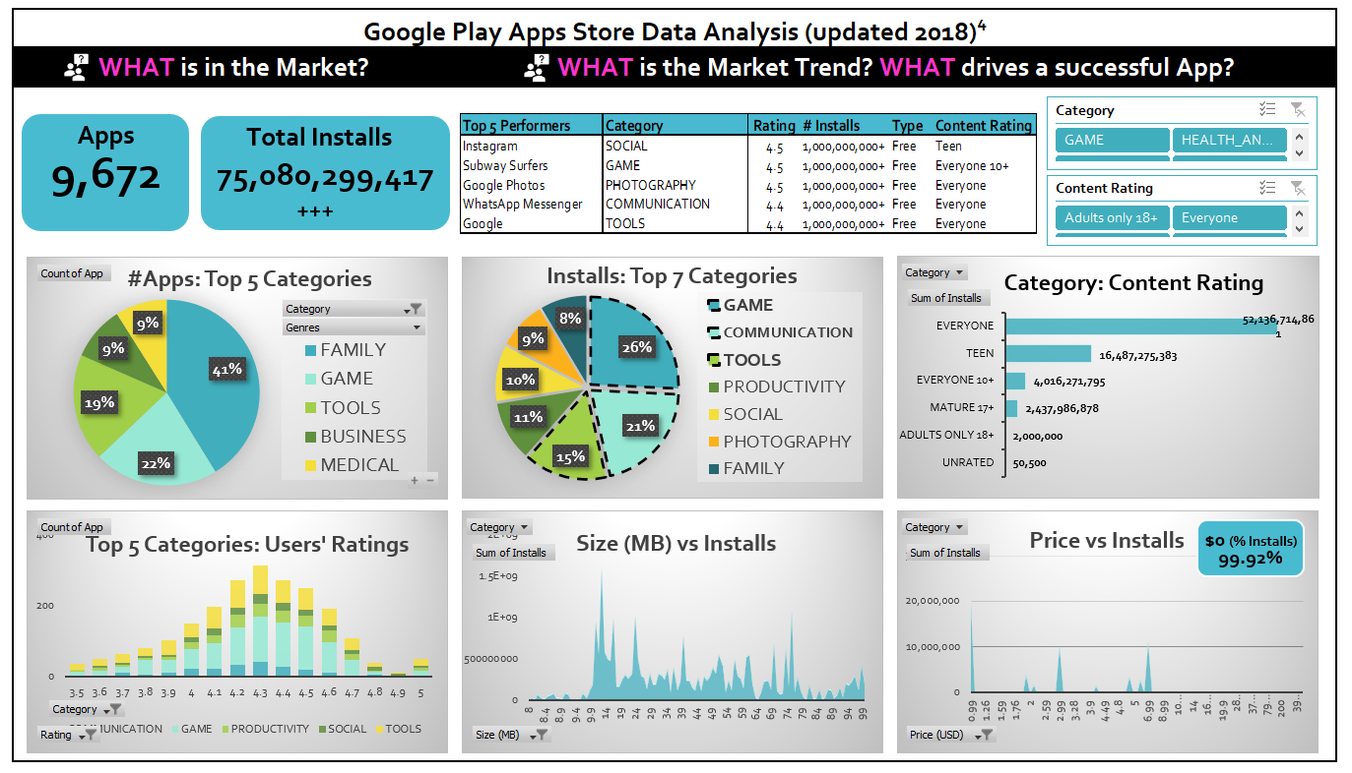
Notes:
Chart 6 ‘Price vs Installs’ : 99.92% installed are free Apps!

Slide 6
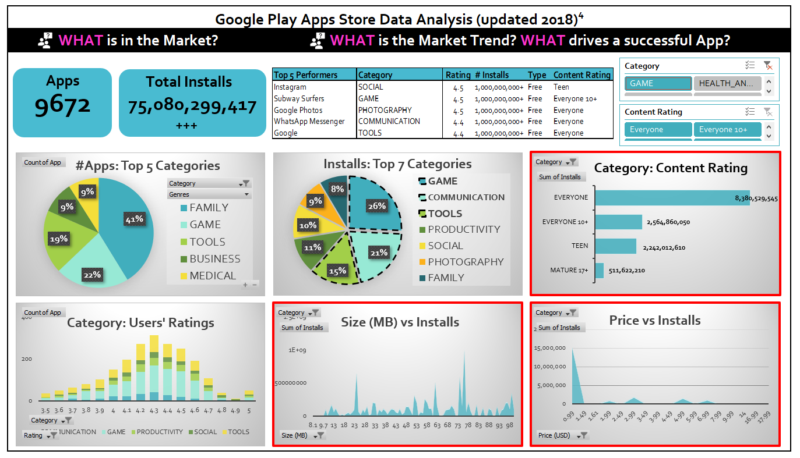
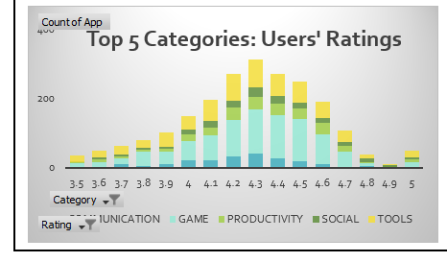
Notes:
Category Slicer is connected to Chart 4,5&6.
Filtered Category: GAME. Charts updated.

Slide 7
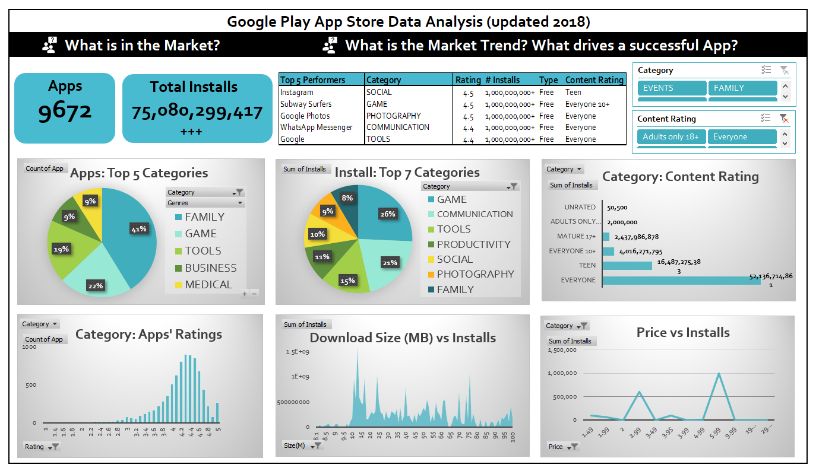

Slide 8
Insights into Android Apps Market
Lucrative Market : $39.7 billion revenue in H1 2019³
TOP 5² : Games, Tools, Communication, Social, Entertainment
FREE : “How to make money?”
Good App Interface : Catchy name, Size, Less effort less time.
Know Your Audience & Competitors
Sources: ³Sensor Tower, July 2019
Notes:
Users spent 39.7 billion in H1 2019.
Downloads (billions) - Q4 2019
3) 99.92% INSTALL are FREE⁴ : Generate revenue from In-App Purchases, Ads, Investors/Sponsors, Freemium (users like the free version, and upgrades to paid version), email marketing
4) App must be easy to remember, easy to find for download. Name hints at what it does (key words). Informative description. Intuitive. Responsive. Easy to use. Quick.
5) Wider audience, creating an App suitable for Everyone : from youngest to oldest users!
6) Competitors : Apps features & weaknesses.

Slide 9




Develop Your App’s Uniqueness!
We feel U!
& Engage Customers!
We hear U!
Notes:
Takeaway message is: 1)
2) & incorporate Customers’ engagement in your business model! Users to enjoy and feel comfortable when using the App.

Slide 10


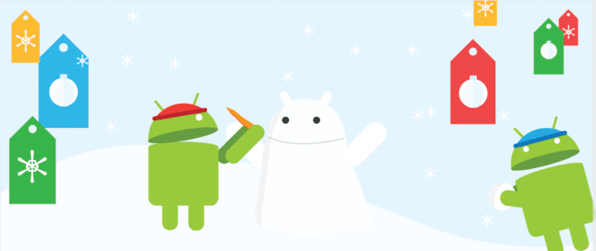
Data Source
⁴Google Play Store Apps | Kaggle https://www.kaggle.com/lava18/google-play-store-apps

